Slide 1
Securing Web Applications in PHP
Presented by : Sushil Wanjari

Slide 2
Agenda
PHP and Security
OWASP Top 10
PHP Performance

Slide 3
PHP and Security
Make sure that any variables being submitted from a web browser are being properly checked
Will this script only affect the intended files?
Can unusual or undesirable data be acted upon?
Can this script be used in unintended ways?
Can this be used in conjunction with other scripts in a negative manner?
Will any transactions be adequately logged?

Slide 4
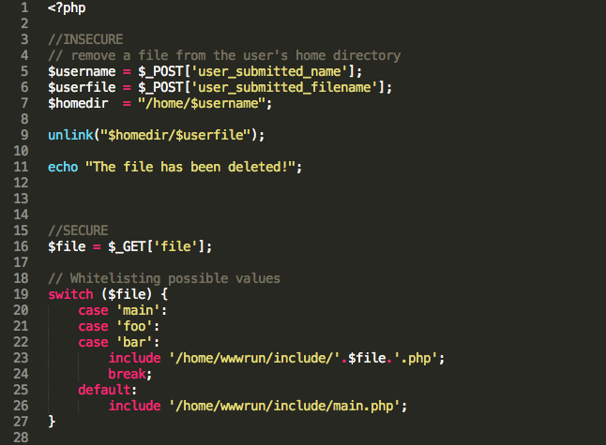
PHP and Security

Slide 5
PHP and Security – Database Security
Applications should never connect to the database as its owner or a superuser
Not to implement all the business logic in the web application (i.e. your script), instead do it in the database schema using views, triggers or rules
Establish the connections over SSL to encrypt client/server communications for increased security
Encrypt the data before inserting it into the database, and decrypt it when retrieving (use mcrypt, mhash etc.)
Hashing
SQL Injection

Slide 6
PHP and Security – Error Reporting
Generic PHP error indicates a system is running PHP
Function error can indicate whether a system may be running a specific database engine, or give clues as to how a web page is designed
A file system or general PHP error can indicate what permissions the web server has, as well as the structure and organization of files on the web server
Solutions:
Scrutinize all functions, and attempt to compensate for the bulk of the errors
Disable error reporting entirely on the running code
Use PHP's custom error handling functions to create your own error handle

Slide 7
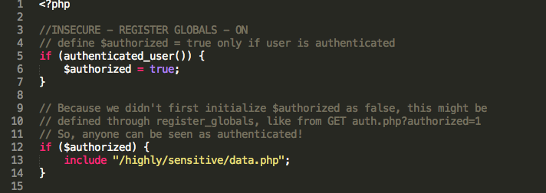
PHP and Security – Register Globals
When on, register_globals will inject your scripts with all sorts of variables, like request variables from HTML forms
DEPRECATED as of PHP 5.3.0 and REMOVED as of PHP 5.4.0

Slide 8
PHP and Security – Magic Quotes
Magic Quotes is a process that automagically escapes incoming data to the PHP script
Affects portability
Affects performance
Inconvenience
DEPRECATED as of PHP 5.3.0 and REMOVED as of PHP 5.4.0

Slide 9
PHP and Security – Hiding PHP
Helps in slowing down an attacker who is attempting to discover weaknesses in your system
By setting expose_php to off in your php.ini file, you reduce the amount of information available to end user
Configure web servers such as apache to parse different file types through PHP, either with an .htaccess directive, or in the apache configuration file itself

Slide 10
PHP and Security – Keeping Current
PHP is under constant scrutiny and improvement
Each new version will often include both major and minor changes to enhance security and repair any flaws, configuration mishaps, and other issues that will affect the overall security and stability of your system
The best approach is to update often, and maintain awareness of the latest versions and their changes

Slide 11
PHP and Security – Filter
Filters data by either validating or sanitizing it
Useful when the data source contains unknown (or foreign) data, like user supplied input
Two main types of filtering: validation and sanitization
Validation is used to validate or check if the data meets certain qualifications
Sanitization will sanitize the data, so it may alter it by removing undesired characters

Slide 12
PHP and Security – Validate Filters
FILTER_VALIDATE_BOOLEAN
FILTER_VALIDATE_EMAIL
FILTER_VALIDATE_FLOAT
FILTER_VALIDATE_INT
FILTER_VALIDATE_IP
FILTER_VALIDATE_MAC
FILTER_VALIDATE_REGEXP
FILTER_VALIDATE_URL

Slide 13
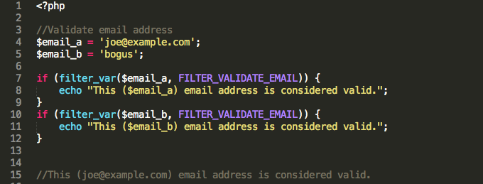
PHP and Security – Validate Filters

Slide 14
PHP and Security – Sanitize Filters
FILTER_SANITIZE_EMAIL
FILTER_SANITIZE_ENCODED
FILTER_SANITIZE_MAGIC_QUOTES
FILTER_SANITIZE_NUMBER_FLOAT
FILTER_SANITIZE_NUMBER_INT
FILTER_SANITIZE_SPECIAL_CHARS
FILTER_SANITIZE_FULL_SPECIAL_CHARS
FILTER_SANITIZE_STRING
FILTER_SANITIZE_STRIPPED
FILTER_SANITIZE_URL
FILTER_UNSAFE_RAW

Slide 15
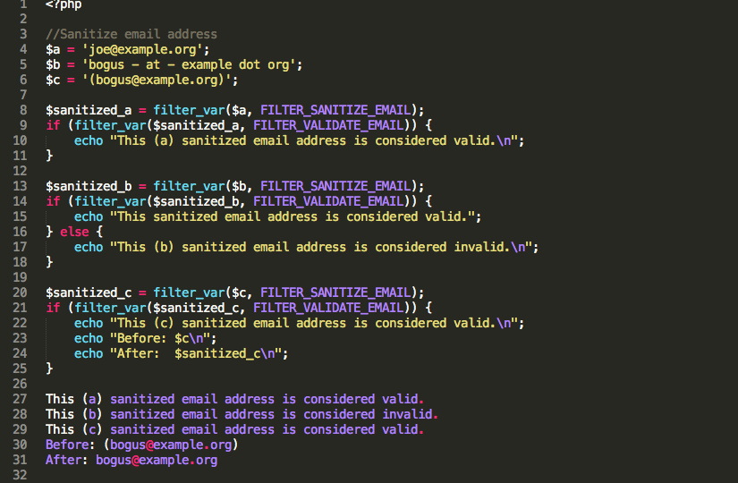
PHP and Security – Sanitize Filters

Slide 16
Cross-site Scripting
Introduction to Cross-site Scripting
XSS within HTML tags or attributes
XSS within <script> tags
XSS with style sheets

Slide 17
Cross-site Scripting - Whitelisting
Regular Expressions
Check if input string matches the acceptable pattern
$name = ‘’;
$pattern = ‘/^[a-zA-Z0-9]*$/’;
if(preg_match($pattern, $_POST[‘username’])) {
$name = $_POST[‘username’];
} else {
echo ‘invalid characters in the username field’;
}

Slide 18
Cross-site Scripting - Whitelisting
ctypes
Use ctypes to varify the data types
bool ctype_digit(string $text);
bool ctype_alpha(string $text);
bool ctype_alnum(string $text);

Slide 19
Cross-site Scripting – Output re-encoding
Use right function to encode for the right context
strip_tags() to remove PHP and HTML tags
urlencode() for CSS and URLs
json_encode() for javascript characters
echo strip_tags('<h1>test heading</h1>');
test heading
echo urlencode('http://php.net/manual/en/function.urlencode.php');
http%3A%2F%2Fphp.net%2Fmanual%2Fen%2Ffunction.urlencode.php
echo json_encode('<script>alert(1)</script>');
"<script>alert(1)<\/script>"

Slide 20
Cross-site Scripting – Output re-encoding
Use right function to encode for the right context
htmlspecialchars() to display user input inside HTML tag blocks
echo htmlspecialchars('<strong>Test</strong>', ENT_QUOTES, ‘UTF-8’);
&lt;strong&gt;Test&lt;/strong&gt;
$strip = strip_tags($_POST[‘username’]);
$user = htmlspecialchars($strip, ‘ENT_NOQUOTES’, ‘UTF-8’);
echo ‘<p> Welcome: ‘ . $user . ‘</p>’;

Slide 21
Cross-site Scripting – Output re-encoding
Between HTML tags
<p><?php echo htmlspecialchars($strip, ENT_NOQUOTES, ‘UTF-8’); ?></p>
Inside HTML attributes
<p id=“<?php echo htmlspecialchars($strip, ENT_QUOTES, ‘UTF-8’); ?>”></p>
Inside URL attributes
<img src=“<?php echo urlencode($strip, ‘UTF-8’); ?>”/>
Inside Javascript
<script>
alert(‘<?php echo htmlencode(json_encode($strip); ?>’);
</script>
Inside CSS
<div style=“background-color:’<?php echo urlencode($strip); ?>’;”></div>

Slide 22
OWASP Top 10
A1 – Injection
A2 – Broken Authentication and Session Management
A3 – Cross Site Scripting (XSS)
A4 – Insecure Direct Object References
A5 – Security Misconfiguration
A6 – Sensitive Data Exposure
A7 – Missing Function Level Access Control
A8 – Cross Site Request Forgery (CSRF)
A9 – Using Components with Known Vulnerabilities
A10 – Unvalidated Redirects and Forwards

Slide 23
Any Questions?

